Slide 1
Air Force Reserve Command Civil Engineer Program Overview
Mr Bob Staib
Chief, Civil Engineer Division
20 Jul 2016
1
Notes:
1
A7P is overall POC for this briefing (same brief used for Annual Robins AFB Requirements Symposium in Nov and SAME Robins AFB Post brief in Jun)
Slide POC: A7PP
Updated: 26 May 13 (changed date)
Civil Engineer
Facilities (construction, maintenance & environmental)
Fire Emergency Services
Emergency management
Explosive Ordnance Disposal
Contracting
Security Forces
AT/FP
Physical Security & Police Services
Combat Arms

Slide 2
Overview
Engineer Responsibilities
Facilities Programs
Installation Ops & Environmental
Civil Engineer Readiness
Where Do I Get More Info?
Notes:
The Defense Strategic Guidance states that, “Our Nation is at a moment of transition,” “a strategic turning point.” The United States must put its fiscal house in order, while the DoD & the Services reshape for the future.
Meeting the myriad strategic & fiscal opportunities & challenges requires leadership.
In A7 we are posturing for the future, whether it involves operating in anti-access environments or capitalizing on evolving resourcing dynamics.
During your visit with our great staff this morning, you will hear them describe some of these efforts.

Slide 3
Engineer Responsibilities
Facility Programs
Installation
Ops & Env
Civil Engineer Readiness
  Program Development
  FOCUS & Community Planning
  MILCON & FSRM prgm dev
  Mission Beddown Facility Spt
  Program Management
  MILCON & FSRM project execution
  Support to base/tenants
  Comprehensive Interior Design
  Installation Operations
  BOS Contract lead
  Infrastructure oversight
  Energy Management
  Environment & Asset Accountability
  Environmental Quality
  Asset Accountability
  Real Property/Real Estate
  Emergency Services
  Fire Emergency Services (FES)
  Explosive Ordnance Disposal (EOD)
  Emergency Management (EM)
  Readiness and Sustainment
  Prime BEEF
  RED HORSE
  Command-wide initiatives
$7.47B Physical Plant & 5,000 Deployable Engineers
Notes:
SCRIPT: Our team of 62 engineers and program managers cover the full spectrum of engineer responsibilities. We generally group these responsibilities into 3 broad areas depicted on the slide:
Facility Programs area covers our larger facility repair and construction efforts via MILCON and FSRM (Facilities Sustainment Repair and Modernization) programs.
Installation Operations and Environmental Programs provide for the day to day operation and stewardship of our real property assets.
Finally, we manage the command’s Civil Engineer Readiness forces of Emergency Services including Fire Fighters, EOD and Emergency Management/CBRN capabilities as well as our Prime BEEF and RED HORSE capabilities.
Bottomline, we have the collective responsibility to manage the commands $7.5B Physical Plant while preparing over 5,000 engineers for potential deployment in support of our Combatant Commanders.
I’ll cover the areas highlighted in bold print in more detail.
NOTES:
Merger: 3 Divisions w/8 Branches merged into One Division w/ 6 Branches; ~ 68 to 62 auth
Plant Replacement Value = ReCap PRV as of “end of FY15”
Our PRV as shown here includes both Host and Tenant locations
* Total AFRC Recap PRV = $7.5 B
* Host PRV & % = $4.65 B; 62%
* Tenant PRV & % = $2.85 B; 38%
Deployable Engineers: ~5,000 (~4,500 TRs, ~100 ARTs,~ 100 AGRs, ~300 IMAs)

Slide 4
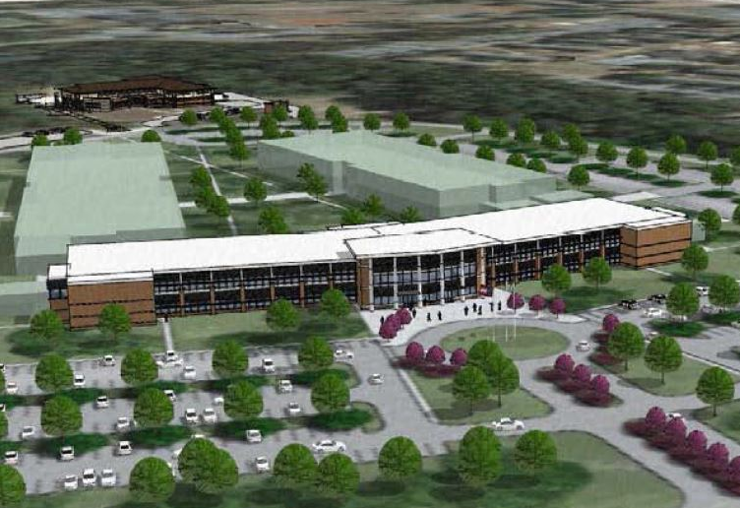
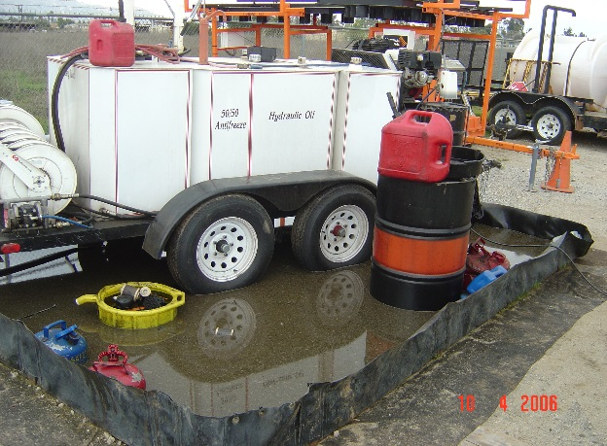
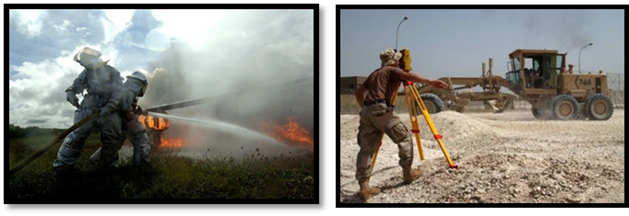
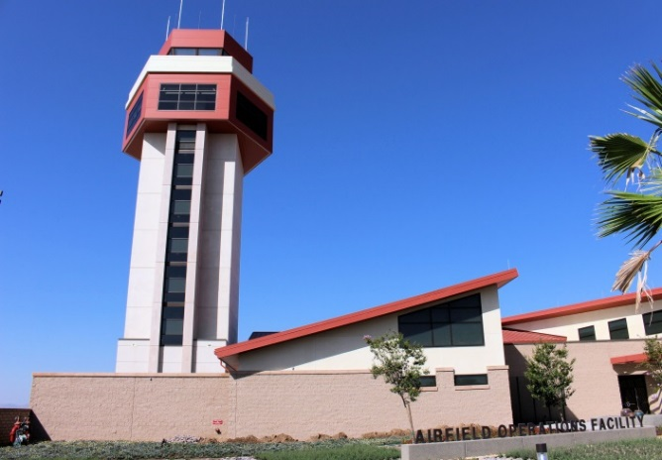
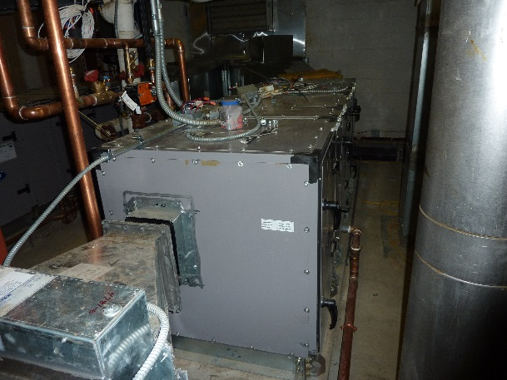
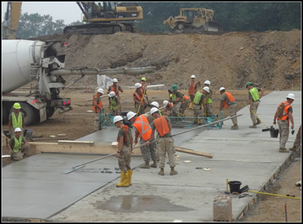
A4C: Civil Engineer Division
A4CA Picture
A4CD: Program Development
Mr Bob Akridge
A4CA: Environmental &
Asset Accountability
Mr Earl Aler
A4CE: Emergency Services
Mr Tom Morris
A4CO Picture
A4CM: Program Management
Mr Scott Wall, Sr
A4CO: Installation Operations
Mr Ray Knapek
A4CX: Readiness & Sustainment
CMSgt Ron Aickelin
Notes:
SCRIPT:
Good morning (afternoon)
NOTES: Pictures, Clockwise
Upper Left: Rendering of Phase I Consolidated Mission Complex, HQ AFRC, Robins AFB
Upper Right: Control Tower and Base Ops Facility, March ARB, FY12 MILCON project which won AF-level Design Award. $18.4M, operational summer 2014.
Lower Right: Expeditionary Civil Engineers lay concrete ramp
Lower Left: Fire Fighters conduct live fire training at an Aircraft Crash Rescue Training Facility

Slide 5

AFRC Footprint
Host & Tenant Installations
Alaska
●
ARPC
Guam
4AF
22AF
HQ AFRC
Hawaii
10AF
9 Host installations – 57 Tenant Locations/Ranges
33 Flying Wings, 12 Flying Groups, 1 Space Wing
Over 70K Citizen Airmen
$7.49B Plant Replacement Value, 21K Acres, ~3K Facilities
Notes:
Slide POC: A7PP, updated 31 May 2013
AFRC plant replacement value of $6.13B or 3.2% of
AF PRV; nearly 1,200 buildings
Nine host installations PRV:$4.10B
Buildings: 13 Million Square Feet (Source: April 2013 Reserve Snapshot)
- About 2 Pentagons – 6,500,000 SF (Source: http://www.infoplease.com/spot/pentagon1.html)
Over 4 1/2 times Empire State Building’s 2,768,591 square feet (Source: http://www.mastersoftrivia.com/blog/2011/05/11-fascinating-facts-about-the-empire-state-building/)
Land: 21,000 Acres (Source: Mr David D’Amore, A7IA)
Equivalent to almost 42 Disneylands (source: http://corporate.disney.go.com/)
Over 19 Perry Agricenters in acreage (source: http://www.gnfa.com/)
Airfield Pavement: 15M Square Yards (Source: April 2013 Reserve Snapshot)
-Equivalent to 4.8 square miles of concrete
Locations: 66 where AFRC has real estate interest
• 5 Air Reserve Bases (Dobbins ARB, Grissom ARB, Homestead ARB, March ARB, Westover ARB)
• 4 Air Reserve Stations (Minn-St Paul IAP ARS, Niagara Falls IAP ARS, Pittsburgh IAP ARS and Youngstown-Warren ARS)
• 3 Navy Tenant Locations (Carswell, JB Pearl Harbor-Hickam, & JB Guam-Andersen)
• 4 Army Tenant Locations (Pope, Ft Sill/Falcon Range, Ft Wolters & JB Lewis McChord)
• 1 ANG Tenant Location (Portland)
• 42 AF Tenant Locations
• 3 Miscellaneous Locations (Minn St. Paul O’Club Annex MN, Rosecrans Memorial Airport MO, and Starvaggi Training Site PA)
• 4 Ranges (Claiborne LA, Clinton PA, Snelling MN, and Consol OH)
Slide POC: A7PP
Updated: 31 May 13 – updated based on data in AFRC Snapshot – Jun 2013
From an operational perspective, the Air Force Reserve Command is one of ten MAJCOMs, and is the largest personnel-wise with nearly 75K people (source: AFR Snapshot, June 2013):
Traditional 48,618; ART—10,400; IMA—8,974; AGR—2,888; Civilian—4,024

Slide 6
Facility Programs
Installation Planning
Base | IDP Status (ECD) | AICUZ Status
Dobbins | Jun 15 | 2011 - Complete
Grissom | Sep 15 | 2014 - Complete
Homestead | Oct 15 | ECD Oct 15
March | Dec 15 | 2005 – Complete (update pending)
Minneapolis | Jul 15 | N/A
Niagara | Aug 15 | 2015 - Complete
Pittsburgh | Jul 15 | N/A
Westover | Jun 15 | 2012 - Complete
Youngstown | Aug 15 | N/A
IDP documents 20-30 year installation development vision
ADP provides details for specific mission areas
(tenants)
  Products maintained on AFRC SharePoint site to facilitate Installation Facility Boards requirements
  On-Site expertise provided to AFRC Installations and Tenants as available
Take-away
  Objective: All AFRC Bases and Stations compliant by the end of Dec 15
Measure: Installation Development Plans(IDP) completed in accordance with AFI 32-7062
Data Source: Program Management Plan and base-reported data
Make sure IDP reflects your priorities
Stick to the plan as much as possible!
Installation planning is cornerstone to long-term program success
3 Mar 14
AFRC/A7PP
Notes:
OPR: A7PP

Slide 7
Facility Programs
FOCUS
  FY07 initiative to evaluate facility use & facility condition at all AFRC operation locations
    Implement consistent standards
    Quantify true facility funding needs
  5 Year Cycle
    1st Round, FY08-11 effort surveyed 47 locations
    2nd Round, FY12-15 plan to survey 33 locations
      Added BUILDER / S-File data
  Challenges
    Right-size units & comply with AF 20/20 by 2020 goal
    Develop executable plans (O&M vs. MILCON)
    Consider changing force structure
    Identify ALL facility requirements
      Utilities, Pavements, Energy, etc.
Standardized, enterprise-wide facility assessment
Notes:
OPR: A7PP
Updated 18 Mar 15
The Focus program began in FY07 as an A7 initiative to put the same set of eyes on all the AFRC facilities at all of the AFRC operating locations.
The intent was to ensure that we were maintaining our facilities to the same standard and to ensure that proper space was available for all organizations. In doing so, we are able to capture our true facility funding needs.
We started the effort back in FY08 on a 4 year cycle in which we visited 46 locations. We are currently in the last year of our second 4 year cycle in which we are visiting 33 locations.
As we visit the different locations and reassess the units, some of the challenges that we are having to deal with include: trying to right-size the units and still comply with the AF 20/20 by 2020 goal and minimizing the use of MILCON funds. In addition, pending force structure changes at many locations make future facility planning difficult.
Current Contractor = J. M. Waller/Versar – San Antonio office, Project leads are retired AF
Avg Cost Round 1 = $3.2M yr (11 locations & assessing 3.2M NSF or 4.3M GSF per year)
Avg Cost Round 2 = $4.2M yr (8 locations & assessing 3.1M NSF or 4.2 GSF per year)
Cost increase due to BUILDER data collection being accomplished in Round 2
Total Assessed 1st Round - 13.0M NSF / 17.4 GSF
Total Assessed 2nd Round – 12.3M NSF / 16.9 GSF

Slide 8
Facility Programs
AFRC MILCON Program Funding
FY17 spike is KC-46 beddown wedge
No current mission projects in FY17-18
Limited P341 used for force structure out-of-cycle change
Louisville COE District is lead for AFRC programs
$M
Countermeasure
All numbers are programmed amounts & include P&D & P341 funds
Continue mission critical, worst first investment focus
Ensure every dollar counts
Objective: Recapitalize AFRC facilities for mission critical requirements
Measures: Program funding vs. $100M requirement to buy down $1B
backlog
Data Source: President’s Budgets
Reduced MILCON funding levels puts additional pressure on O&M FSRM Program
30 Nov 13
A7PP
Notes:
OPR: A7PP
Updated 18 Mar 15: Changed validated MILCON backlog from $1.4B to $1B (~$400M in lodging projects removed).
AFRC FOCUS program has validated $1B in AFRC MILCON requirements. The AF MILCON program is very limited. AFRC has established $100M as a reasonable level of execution per year to buy-down the MILCON backlog over an approximately 10 year period. FOCUS now concentrating on O&M solutions to fix condition/space deficiencies
Out-year fund line drives pressure for O&M solutions, hurts new mission chances
Average MILCON program over last 22 years = $41.49M ($26.413M without inserts)
Highest funding years were 2010 ($107.6M—largest in AFR history), 2005 ($100.9M), & 2006 ($95.687M)
Lowest funding years were 2011 ($3.413M), 1991 ($3.85M), & 2013 ($6.1M)
FY13 is third lowest MILCON program funding in the last 22 years. In FY13, strategic pause in AF MILCON due to Force Structure Announcement; AF program limited to Corporate initiatives & New Mission MILCON, using $900M+ for higher priority bills.
Congress added $83M to AFR request in FY10; no Congressional inserts or adds since
FY11-13 AFR MILCON funding was short $62.9M vice 3.8% MILCON equity (in past rounded up to 4%)—most severely underfunded 3 year stretch in last 22 years
FY11 received 0.6% of $1.2836B AF TOA vice 3.8% equity (3.2% short = $40.9M)
FY12 received 2.4% of $1.3769B AF TOA vice 3.8% equity (1.4% short = $18.7M)
FY13 received 2.9% of $375.9M AF TOA vice 3.8% equity (0.9% short = $3.3M)
========================
FY10 MILCON Auth/Approp 15 projs, $107.6M awarded (Largest in AFRC history)
FY11 MILCON Auth/Approp 1 Proj, $7.8M – 1 proj @ Patrick AFB Munitions Maintenance Facility)
FY12 MILCON Auth/Approp (March ATC Tower/Base Ops $16.4M; Charleston RED HORSE Training $9.6M)
FY13 PB MILCON Auth/Approp ($6.1M for Niagara C130 Simulator)
FY14 PB MILCON Auth/Approp
March Deployment Processing Center, $19.9M
Tinker Air Control Group, $12.2M
Homestead Entry Control Gate, $9.8M
FY15 PB MILCON Auth/Approp
Robins Consolidated Mission Complex Ph 1, $27.7M
Seymour Johnson Tanker Parking Apron Expansion, $9.8M
NAS Ft Worth EOD Facility, $3.7M

Slide 9
Facility Programs
Future MILCON Projects
40 “top tier” Projects
  $382M Current Mission
  Host & Tenant locations
Representative Projects Range $5M - $40M
Ensuring our Installations are Ready, Capable & Viable
Notes:
Slide POC: A7PP
Updated: 31 May 13 – Source: AFRC/CC Approved FY15 MILCON IPL
Our facility investment strategy focuses on right-sizing, sustaining & recapitalizing our installation power projection & training platforms
1 Robins GA HQ AFRC Phase 1
2 Seymour J. NC Tanker Parking Apron Expansion
3 Davis M. AZ Guardian Angel Operations
4 Dobbins GA Fire Station / Security Complex
5 Westover MA C-5 Aircraft Maintenance Shop Facility
6 Carswell TX Add Simulator Bay, Building 1792
7 Keesler MS Aeromedical Staging Squadron
8 Lackland TX Consolidate 433 Medical Facility
9 Homestead FL Add Simulator Training Facility, B191
10 Homestead FL Live Ordnance Load Area
11 Youngstown OH Firing Range
12 Dobbins GA Fitness Center Facility
13 Westover MA AF Regional ISO Maintenance Hangar
14 Whiteman MO Munitions Trailer Maintenance Facility
15 Grissom IN Aircraft Maintenance Hangar (Nose Dock 5)
16 Robins GA Consolidate HQ AFRC Phase 2
17 Hill UT Reserve Medical Training Facility
18 Anderson GU ASTF Facility Addition
19 Maxwell AL Aircraft Parking Ramp
20 Pittsburgh PA Wing Headquarters

Slide 10
Facility Programs
AFRC FSRM Program Funding
Great Teamwork! CE, FM, CONS, CoE, JA
Bought out executable FY15 requirements
6 yr obs avg: $172M/yr
$200M FY16 FSRM IPL approved
Budget cuts will drive IPL importance and discipline
Execution goal between 2%-4%PRV
($150-$300M)
Buy down $1.5B O&M FOCUS-validated backlog
MILCON reductions mean higher need for O&M FSRM
4% PRV
$M
2% PRV
Objective: Recapitalize AFRC facilities to meet critical mission requirements
Measures: Program funding vs. 2%-4% PRV ($150-$300M/yr) to maintain facilities
Data Source: Execution, FY16 PB
Countermeasure
Continue “worst-first” AFRC Corp. Structure approved strategy
Investing 2-4% of PRV Keep Good Facilities Good
10 Aug 12
A7PD
Notes:
The chart shows project funding only (EEIC 521, 522, 524, 529)
It does not include Civ Pay, supplies or other O&M requirements (PECs 52576, 52578)
As shown here, AFRC did quite well in FY15 in the SRM arena
CE worked hard with FM, CONS, the Corps and JA to ensure we were ready to execute EOY fallout
This resulted in the execution of $159M in requirements
This EOY funding allowed us to buy-down approximately $102M of our FOCUS validated backlog of facility requirements.
And the AFRC Commander recently approved us building a $200M Integrated Priority List for FY16 to ensure we remain able to execute any fallout
Sustained investment significantly above PB, however, our investment remains in line with recommended industry standards. In FY15 we executed at 2.4% of our PRV… and given the recommended industry standard of 2% of PRV, 2.4% is a good news story given our ongoing backlog.
NOTES for FY16:
1% PRV = $74.5M
2% PRV = $149 M
3% PRV = $223.5M
4% PRV = $298 M
AFRC is executed at about 2.4% of our PRV….

Slide 11
Installation Ops & Environmental
Environmental & Asset Accountability
Environmental Quality
  Maintain compliance, Implement EMS
  Manage National Environmental Policy Act (NEPA) actions
Asset Accountability
  Prioritize infrastructure requirements
Real Property/Real Estate
  Real Property records and inventory accountability
Items of Interest:
  AFFF Recovery/Replacement
  Storm Water Pollution Prevent Plan Updates
  Environmental Storage Tank Upgrades
  Environmental Staff Support

Slide 12
Installation Ops & Environmental
Installation Operations
BOS Contract Integrator and Commodity Lead
  Utilities, Custodial Services, Grounds Maint., Refuse, Pest Control
  Air Force Common Levels of Service (AFCOLS)
Reach-back Engineering Expertise for Installations
  Civil, Electrical, Mechanical
Infrastructure Oversight
  Airfields, Pavements, Utility Systems, POL Systems
Energy Management
Items of Interest:
  BOS Contract Re-competes
  Energy Resiliency

Slide 13
Installation Ops & Environmental
BOS Contracts
Tab A – General (A4CO/PKA)
Tab B – Base Supply (A4OP)
Tab C –Vehicle Mgt (A4RX)
Tab D – Traffic Mgt (TMO) (A4RF)
Tab E – Transient Aircraft Mgt (A4MA) (not all installations)
Tab F - Real Property Mgt (A4CO)
Tab G – Fuels Mgt (A4RM)
Tab H – Airfield Mgt (A3VA)
Tab I – Weather Services (A3VA) (not all installations)
Installation | Contract Award | Orientation Start | Contract Start
Westover ($10M/yr) | Mar 2016 | Mar 2016 | May 2016
Dobbins ($7M/yr) | Oct 2016 | Oct 2016 | Dec 2016
Youngstown ($6M/yr) | Oct 2016 | Oct 2016 | Dec 2016
Pittsburgh ($7M/yr) | Nov 2016 | Dec 2016 | Feb 2017
Grissom ($8M/yr) | Apr 2017 | May 2017 | Jul 2017
Homestead ($7M/yr) | Jun 2017 | Jul 2017 | Sep 2017
March ($9M/yr) | Mar 2018 | Apr 2018 | Jun 2018
Niagara ($5M/yr) | Mar 2019 | Apr 2019 | Jun 2019
Roughly $60M/yr across AFRC
Notes:
SCRIPT: Transitioning into our Installation Ops area, we’re the lead functional for the BOS contracts that provide mission support capabilities to our host installations.
We have BOS contracts at all of our host bases except Minneapolis St Paul which is a civilian government operation
The three bases coded “yellow” are the result of a series of protests we’ve recently encountered causing us to go to interim contract arrangements until protest are resolved.
We just recently resolved a protest at Westover with the new contract starting in May 2016, vs an award originally scheduled in FY15.
We’ve got a game plan to get these three bases on track over the next six months. In the meantime, those locations need to watch their expenses closely
This is another key area where TYD funding supports a cross-functional team to ensure we establish a good, executable game plan when transitioning/updating these complex contracts
NOTES:
Pittsburgh and Youngstown BOS solicitations were both protested to US Court of Federal Claims
The solicitations for both bases have been extended indefinitely
A decision from the Court is due in July 201^
Sole Source Bridge Contracts are in place to allow contract coverage until the protest is resolved
Single contractor for all tabs provides more bid interest, better bid prices, single point of contact to resolve issues
Once Grissom is awarded all installations will have moved from old 10 year contract to new 5 year contract.
Most tabs are 90% firm fixed price; CE tab is roughly 50% firm fixed price

Slide 14
Civil Engineer Readiness
Emergency Management
  BOS and Expeditionary EM Program Management
  Reach-back Technical Support
Explosive Ordnance Disposal
  BOS and Expeditionary EOD Program Management
  Reach-back Technical and Training Support
Fire Emergency Services
  BOS and Expeditionary FES Program Management
  PPE Barcode Inventory & Tracking
Engineer Force Structure and Force Development
  Prime BEEF/S-Teams & RED HORSE
  Silver Flag/MEET/Special Capes - DFT/IRT/TTP
Readiness
  SORTS/ART/DRRS Analysis
  AEF Sourcing - Mobilizations/Deployments
Command-wide Initiatives
  Consolidated Eqmt Mgmt Facility (CEMF)
  Expeditionary Combat Support Training Certification Center (ECS-TCC)

Slide 15
Where Do I Get More Info?
  Request for Information (RFI)
  Sources Sought Synopsis
  Pre-solicitation Notices
  Award Notices
  Requests for Quotes/Proposals
    Government-wide Point of Entry (GPE)
      http://www/fedbizopps.gov
      http://www.ebuy.gsa.gov
  AF Budgets – current and historical
    http://www.saffm.hq.af.mil/budget/index/asp
Notes:
Slide POC: A7K
Updated: 11 Jun 13. No change except POC from A7PM to A7K
All requirements subject to public notice that exceed $25K are advertised in FedBizOpps or GSA Ebuy. This includes supplies, services, and construction.
Other Links
AFCEC
HQ AFRC/A7
SAME National
SAME Robins Post
Events coming
2014 SAME SE Regional JETS, 24-26 Jun, Savanna
SAME/DBIA Fed Proj Delivery Symposium - August 19-21, DC
DBIA Conference & Expo October 6-8, Dallas
SAME Small Business Conference December 9-11, Kansas City

Slide 16
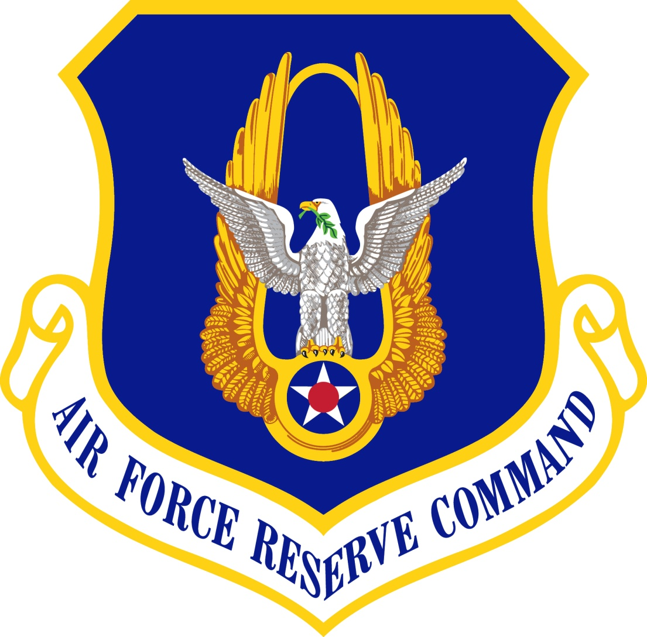
Questions?
Notes:
Slide POC: A7P
Updated: 26 May 13 (no changes)

